Slide 1


4rd semester (2 years)
B.Tech(COMPUTER ENGINEERING)

Slide 2
-:Prepared by:-
-:GUIDED BY:-
Prof. Krishna Patel
Harshit Rathod (D20DCE178)

Slide 3
-:PROGRAMMING IN PYTHON (CE259):-
REAL TIME CURRENCY CONVERTOR

Slide 4
-:Why this project:-
User can convert any currency into any currency .

Slide 5
Desktop application
-:Project Category:-

Slide 6

-:Technology used:-

Slide 7
-:Hardware And Software Requirements:-
Software Requirements:
Developed the System By:
Operating System: Windows 10
Developing Language: Python
Developing Tools:Pycharm IDE , Tiknter GUI

Slide 8
-:Hardware Tools Requirements:-
Hardware Tools:
Developed The System By:
Processor: Intel Core i5
Ram minimum 4 gb
Storage minimum 7 gb

Slide 9
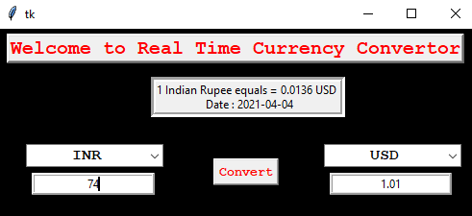
Project screenshots

Slide 10
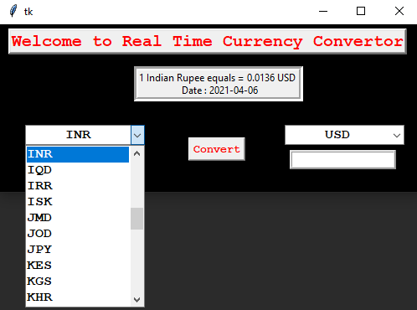

Slide 11
Thank You…..!

